Slide 1

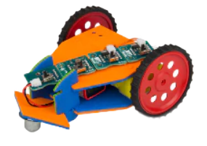
RAJASTHAN INSTITUTE OF ENGINEERING AND TECHNOLOGY ,Jaipur
Innovation & Incubation
Centre of excellence
PRESENTATION ON THE TOPIC
‘ ROBOTIC CAR MODEL ’
SUBMITTEDBY:-
DINESH KUMAWAT & BADAL CHAUDHARY

Slide 2
INTRODUCTION
ROBOTIC CAR MODEL
Robotics cars are used for various purposes such as electronically controlled wheel chair, weight-lifting, to get a work done in accurate & precise manner. The Circuit comprise of an 8051 family micro-controller, an LED light and some commonly available components. It is easy to build and even a beginner with minimal skill level can assemble it.
Features :
1 Switch-controlled land Rover.
2. Program code saved in non-volatile memory (EPROM).
3. Reliability due to use of the microcontroller.
4. No mechanical wear and tear.
5. Easy to build and use.

Slide 3



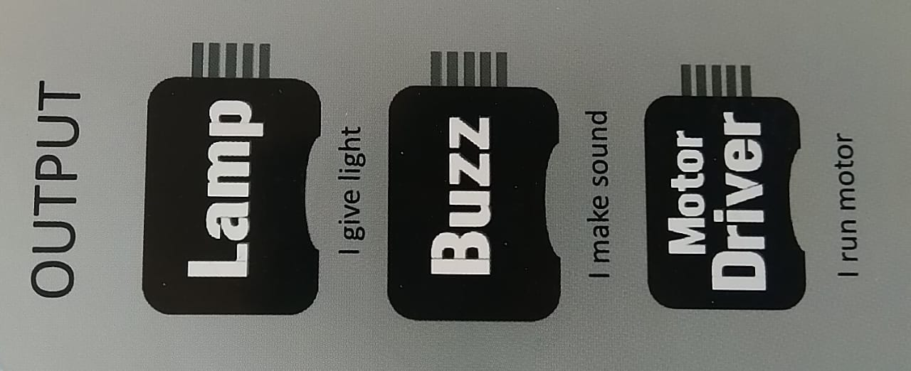
Component used to make car model

Slide 4
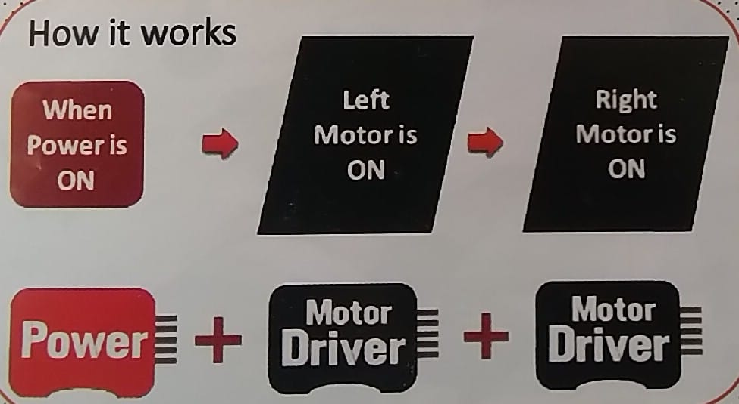
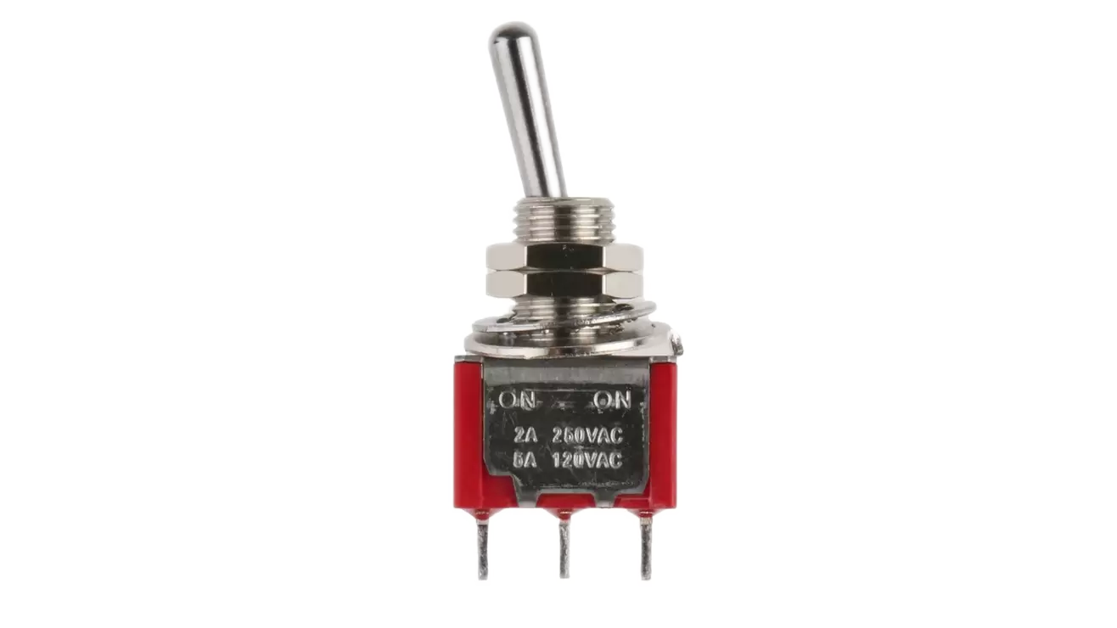
Build a Simple Racing Car
We use the Switch of the Motor Driver to move the wheels in same direction
When a switch of single motor driver get off then the model of car move in circular direction of left or right

Slide 5
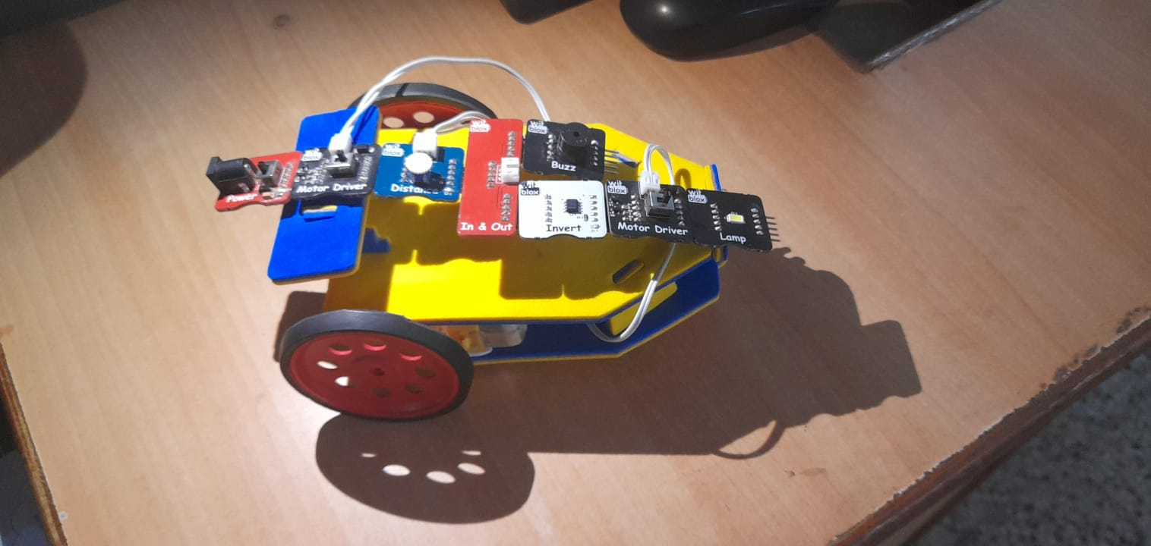
Build an obstacle Avoider Robotic Car Model

Slide 6

MODEL WORKING PRINCIPLE
Left motor remains always
ON
But invert says no
Right motor is Off
When
Power is
ON
Is there any obstacle in front of distance sensor
++
But invert says yes
Right motor is On

Slide 7


